Slide 1
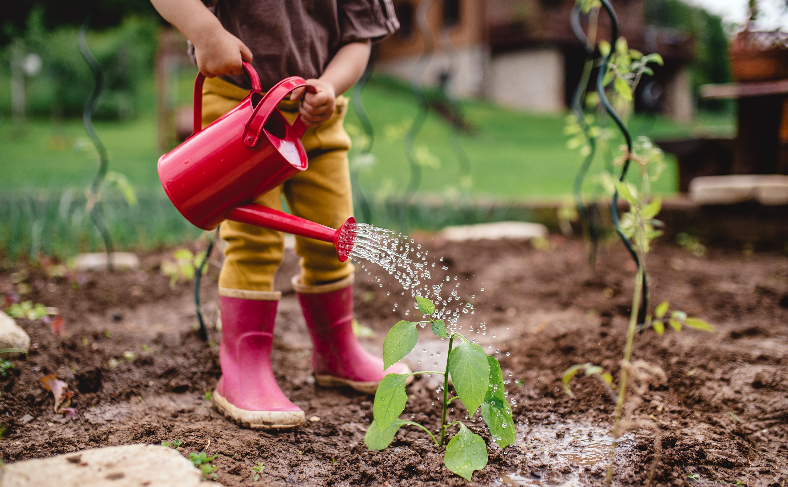
Smart Plant Watering System and Data Logger
Onur Tezgel Kaan Bayraktar

Slide 2
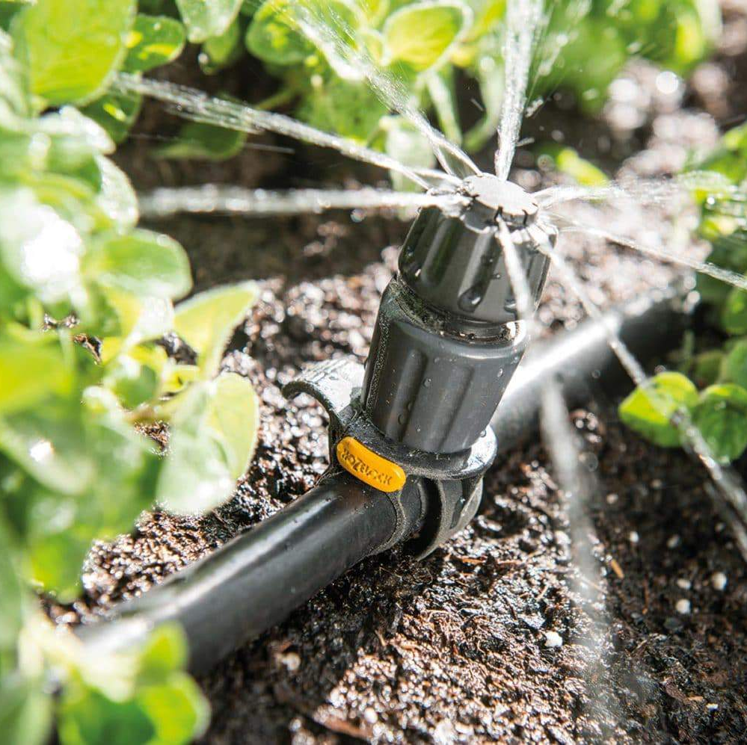
Project Objectives
Automated watering based on soil moisture conditions.
Data logging for historical analysis.
Visualization of environmental data via OLED display.

Slide 3
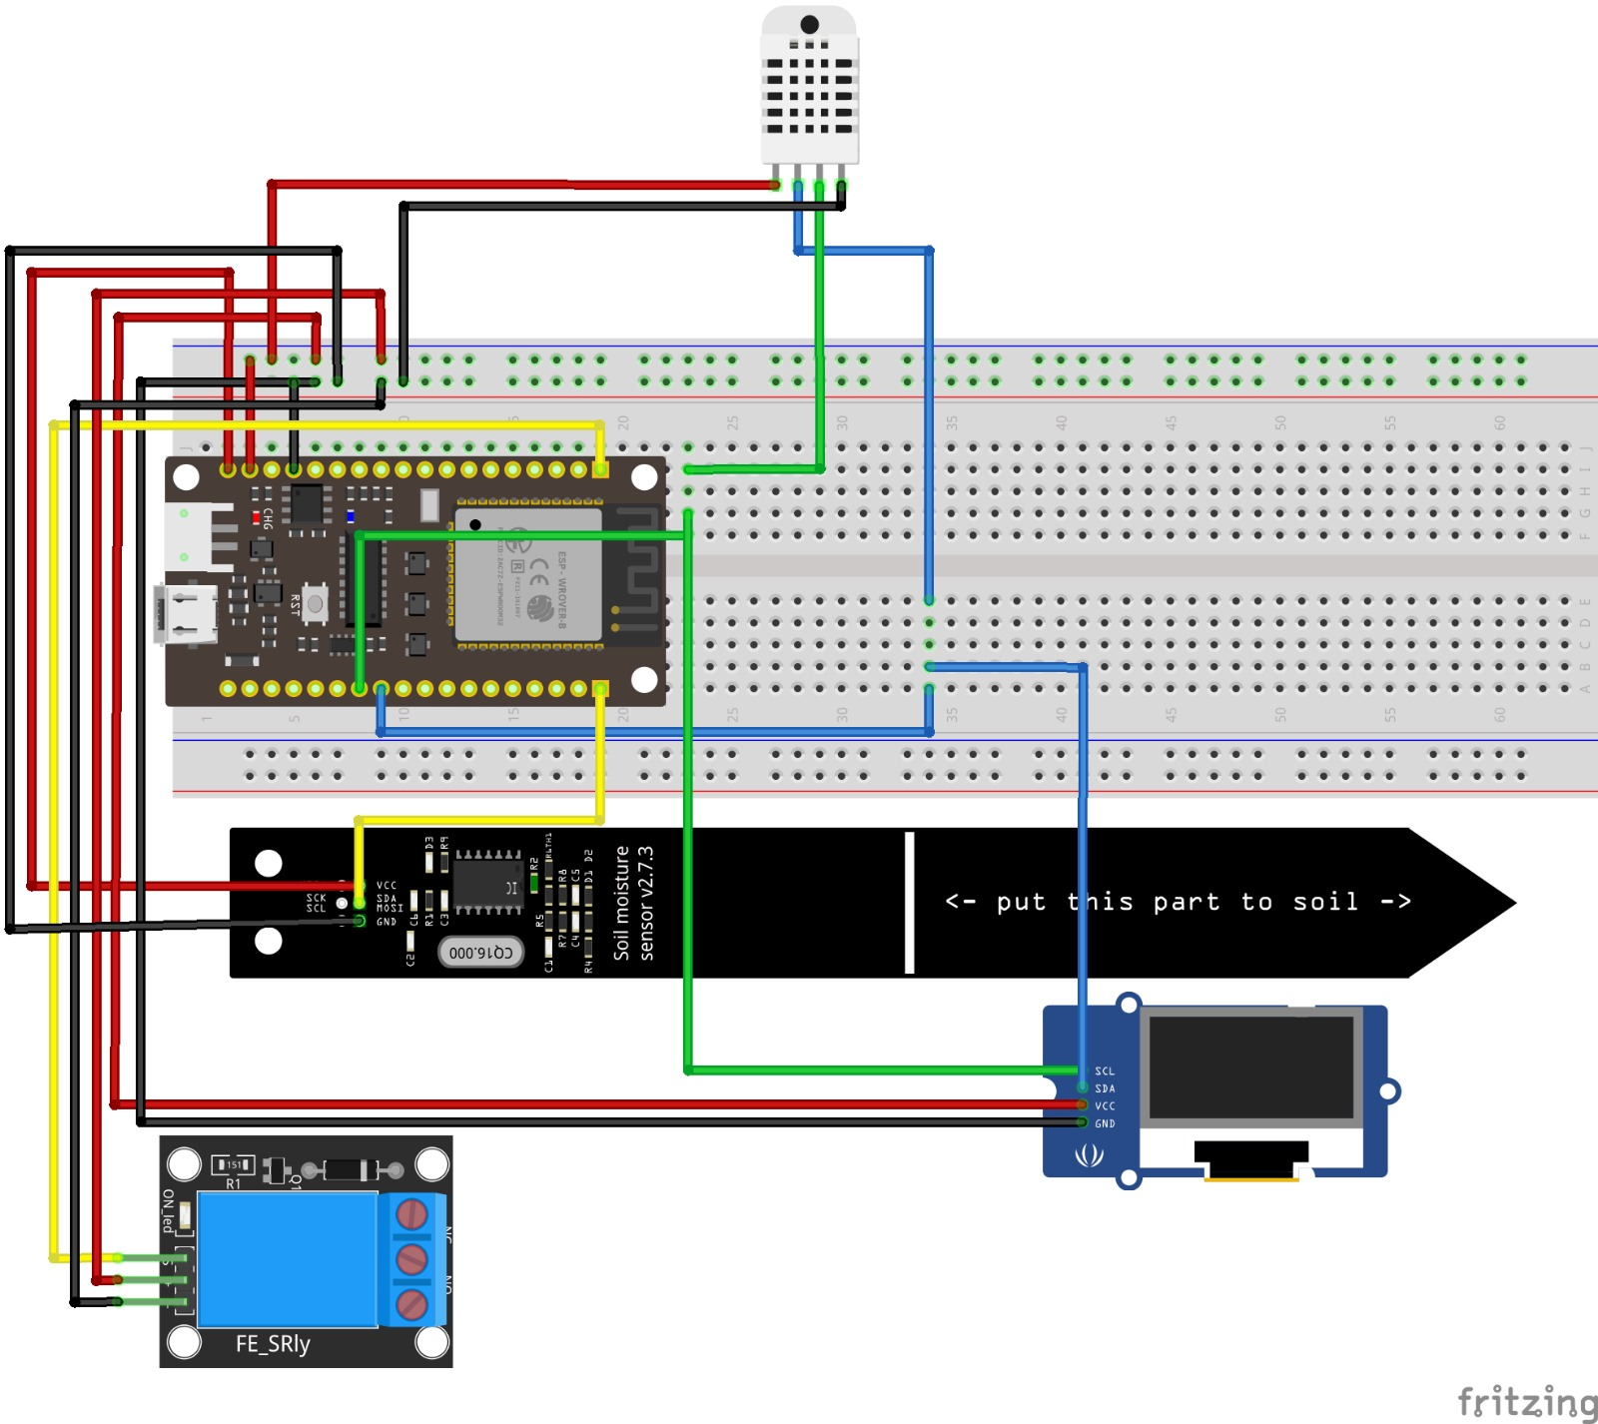
Components Overview
ESP32 as the MCU.
Soil moisture, humidity, and temperature sensors.
Relay module for water pump control.
OLED display for visual feedback.

Slide 4
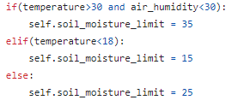
Hardware Integration 1) Sensor Integration
Soil moisture, humidity and temperature sensors are connected to the ESP32.
ESP32 processes sensor data based on predetermined thresholds to make watering decisions.

Slide 5
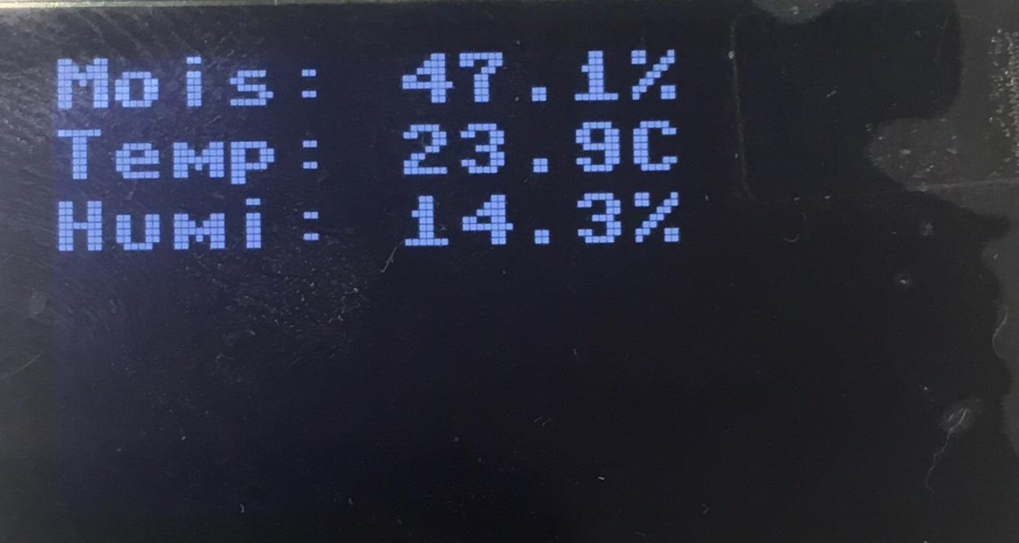
Hardware Integration 2) Relay Integration
Relay module controls the water pump based on ESP32 decisions.
Ensures efficient water supply to the plants.
3) OLED Display
Real-time display of
Soil moisture
Humidity
Temperature

Slide 6

Data Logging in ThingSpeak
Historical data logged from sensors.
Timestamped and stored for analysis.
Enables users to track environmental conditions over time.
Smart-Plant-Watering-System - ThingSpeak IoT

Slide 7
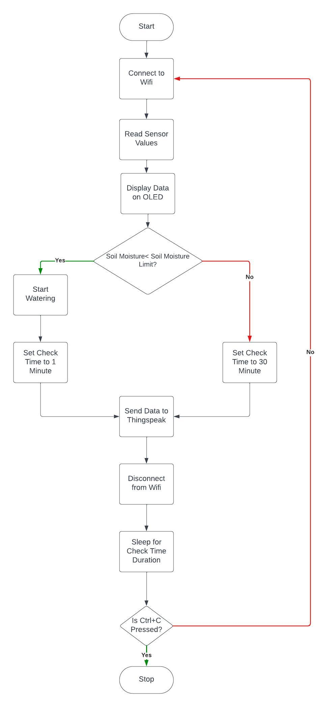
Software Flowchart

Slide 8
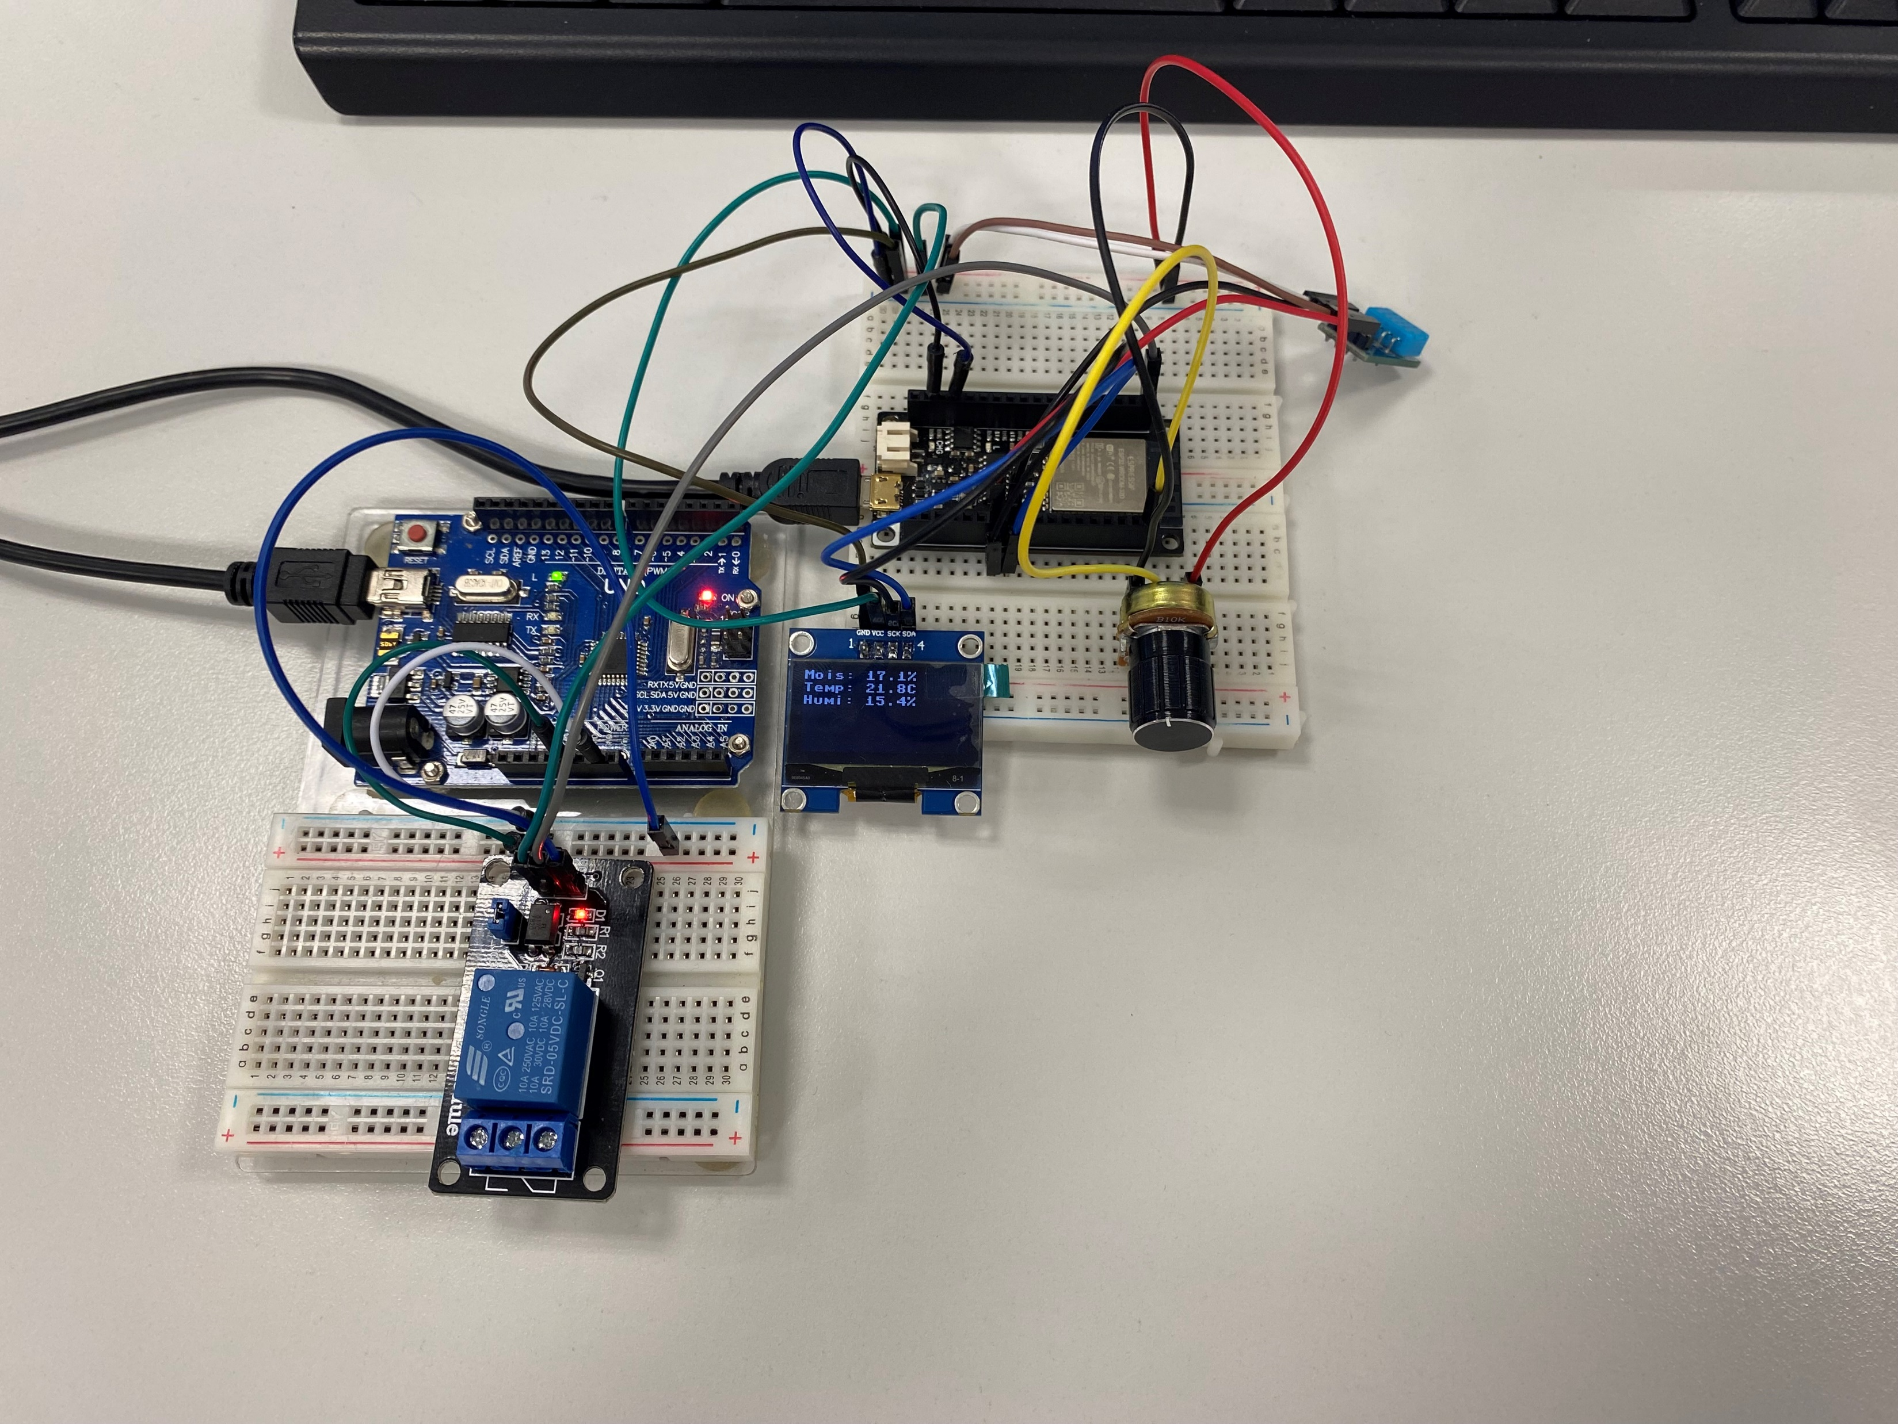

Slide 9
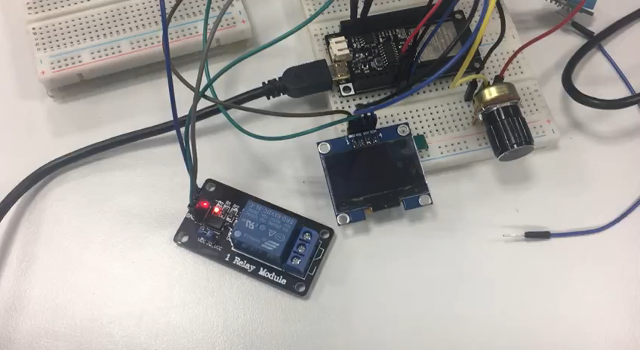
Demo Video

Slide 10
Thank You For Listening
Feel free to ask any questions.

